Slide 1

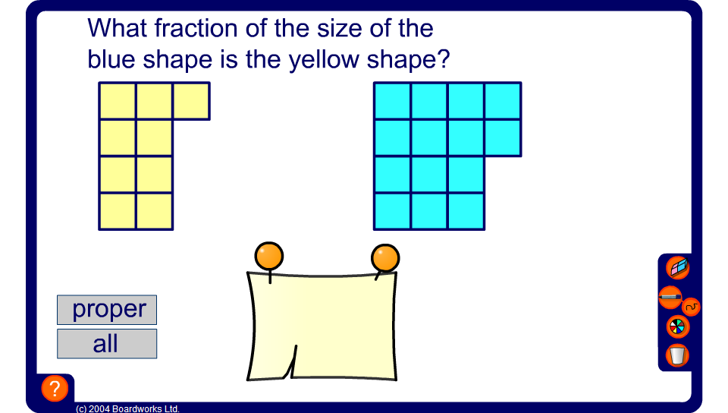


Writing one amount as a fraction of another
Notes:
Ask pupils to tell you what fraction the yellow shape is of the blue one. Ask pupils to cancel their answers as appropriate or convert to mixed numbers.

